Slide 1

How does an electrical circuit work?
Exploring Ohm’s Law in parallel and series circuits

Slide 2

How does an electrical circuit work?
Exploring Ohm’s Law in parallel and series circuits
^{Objective}
The purpose of this activity is to explore Ohm´s Law in parallel and series circuits, to create a hypothesis. The hypothesis will be tested during an experiential activity using the Labdisc current and voltage sensors.

Slide 3


How does an electrical circuit work?
Exploring Ohm’s Law in parallel and series circuits
^{Introduction and theory}
^{Introduction}
Nowadays, electric circuits are an indispensable part of our life. Have you ever wondered how many devices in your house work thanks to electricity? A LOT! For example the refrigerator, radio, PlayStation, lamps, microwave, cell phones, washing machine and many more.
Think of a device that works with an electric circuit. Does it make your life more comfortable? Why?
Do you know the different parts of an electric circuit? Name them.

Slide 4
How does an electrical circuit work?
Exploring Ohm’s Law in parallel and series circuits
^{Introduction and theory}
Carry out the experiment activity with your class. Following which you’ll be able to answer the following question.
Do you think electric energy can be transformed into another kind of energy?

Slide 5
How does an electrical circuit work?
Exploring Ohm’s Law in parallel and series circuits
^{Introduction and theory}
^{Theoretical}
Electric circuits
Currently there are lots of devices that work with electric circuits. For example, your computer and electrical appliances have a lot of circuits inside. In the first place, we need to remember that an electric current is a flow of charge that passes through a conductor. A conductor is some sort of material that allows electric current to pass through it, while an insulator is a material that doesn´t conduct. An electrical circuit works by connecting some specific elements together so that the electricity can pass through it. These elements include:
Power supply – for example a battery
Conductor – as mentioned, any material that allows a flow of charge to pass through it for example a copper wire

Slide 6
How does an electrical circuit work?
Exploring Ohm’s Law in parallel and series circuits
^{Introduction and theory}
Load – loads are devices that use electric current. They transform electrical energy into another kind of energy, for example light, acoustic, thermal or mechanical energy. Light bulbs are a type of load that transform electric energy into light and thermal energy.
Switch – regulates the flow of current by closing or breaking the circuit
During this class we will study two kinds of circuits: series circuit and parallel circuit. Both are simple forms of circuits, but each have different characteristics.
Series circuits connect several loads on the same connector, i.e. there is only one possible path along which the electrical current can flow. Parallel circuits connect loads with different paths, making one load independent of the other, i.e. if one of the paths is broken, the other paths will continue to work.

Slide 7
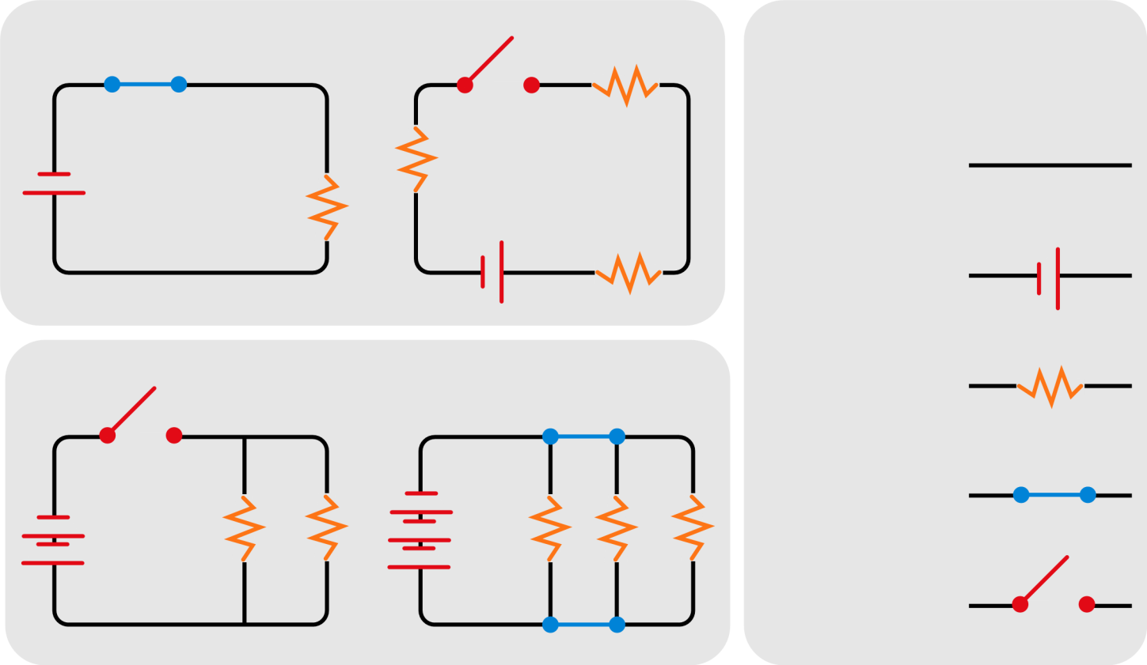
How does an electrical circuit work?
Exploring Ohm’s Law in parallel and series circuits
^{Introduction and theory}
The following page presents diagrams of parallel and series circuits.
Series circuit
Symbols used in electric circuit diagrams
Conductor
Power Supply
Parallel circuit
Load
Closed Switch
Open Switch

Slide 8






How does an electrical circuit work?
Exploring Ohm’s Law in parallel and series circuits
^{Introduction and theory}
Both circuits represent a different relationship between load resistance, electric current and voltage:
Series circuit Parallel circuit
Where:
V_{T} = Total voltage
I_{T} = Total current
R_{T} = Total resistance

Slide 9
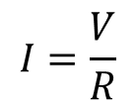
How does an electrical circuit work?
Exploring Ohm’s Law in parallel and series circuits
^{Introduction and theory}
Ohm´s Law establishes that there is a direct proportionality between electric current (I) flowing between two points of an electrical circuit and the potential difference of voltage (V) applied across a conductor. Between these two parameters there is a constant proportionality equal to the inverse of the load resistance.
The mathematical form of the law is shown below:
Where:
I = Electric current
V = Voltage
R = Resistance

Slide 10
How does an electrical circuit work?
Exploring Ohm’s Law in parallel and series circuits
^{Introduction and theory}
Now students are encouraged to raise a hypothesis which must be tested with an experiment.
Suppose you have two different electrical circuits; one parallel circuit and one series circuit. Each one has three loads, one switch and one battery. What do you think the variation in voltage and electric current of each circuit will be?

Slide 11

How does an electrical circuit work?
Exploring Ohm’s Law in parallel and series circuits
^{Activity description}
Students will create two types of electrical circuit; one series circuit and one parallel circuit, to observe and understand how it works. They will also prove Ohm´s law experimentally. To do it they will study both circuits measuring both, current and voltage, at different points of the electrical circuit.

Slide 12
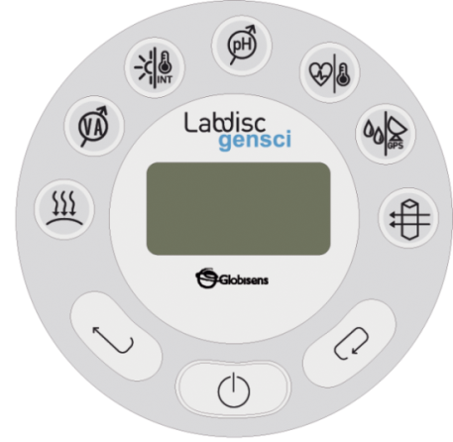
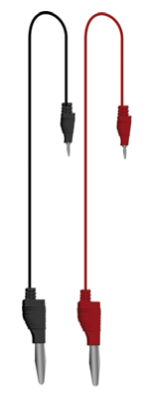
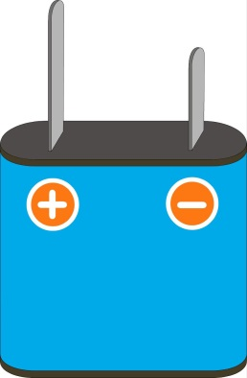
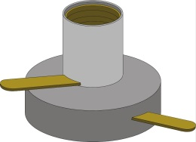
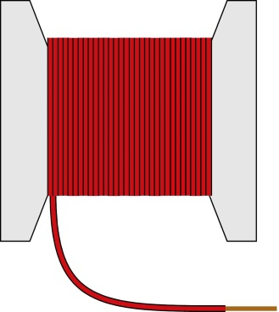
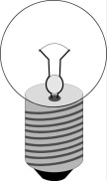
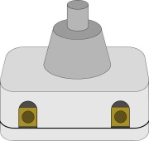
How does an electrical circuit work?
Exploring Ohm’s Law in parallel and series circuits
^{Resources and materials}
Labdisc Gensci
Red and black banana to banana connector cables
Battery (4.5 V)
6 light bulbs (6 V)
6 light bulb holders
2 switches
Copper wire (1m approximately)
Pliers
6
7
7
6

Slide 13



How does an electrical circuit work
Exploring Ohm’s Law in parallel and series circuits
^{Using the Labdisc}
^{Labdisc configuration}
To collect measurements with the Labdisc and thermocouple sensor, the Labdisc must be configured according to the following steps:
Turn on the Labdisc .
Press and select “SETUP” by pressing .
Now select option “SET SENSORS” by pressing and select “Voltage”.
On the setup menu, press and select “SAMPLING RATE” with .

Slide 14
How does an electrical circuit work
Exploring Ohm’s Law in parallel and series circuits
^{Using the Labdisc}
Select “MANUAL” with and then press three times to go back to the measurements and run the Labdisc pressing .
Once you have finished measuring, stop the Labdisc by pressing (you will see the instruction “press SCROLL key to STOP”) and press .

Slide 15
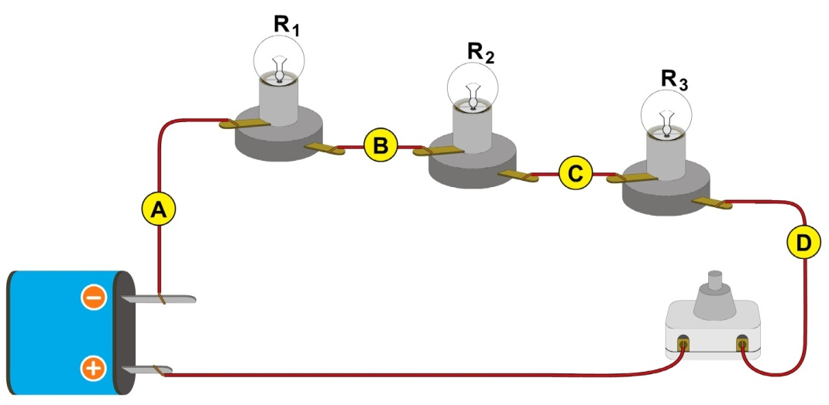
How does an electrical circuit work?
Exploring Ohm’s Law in parallel and series circuits
^{Experiment}
Build a series circuit and a parallel circuit using the materials listed before as shown in the figure. Make sure the copper wire is connected tightly to the parts of the circuit, by using the pliers.
Turn the series circuit on and start measuring. Record voltage of R₁ (V₁) by placing the electrodes at points A and B of the diagram. Once the measurement stabilizes, record the sample. If the voltage value turns out negative switch the electrodes, i.e. place the red electrode where the black electrode was connected and vice versa.
Series circuit

Slide 16
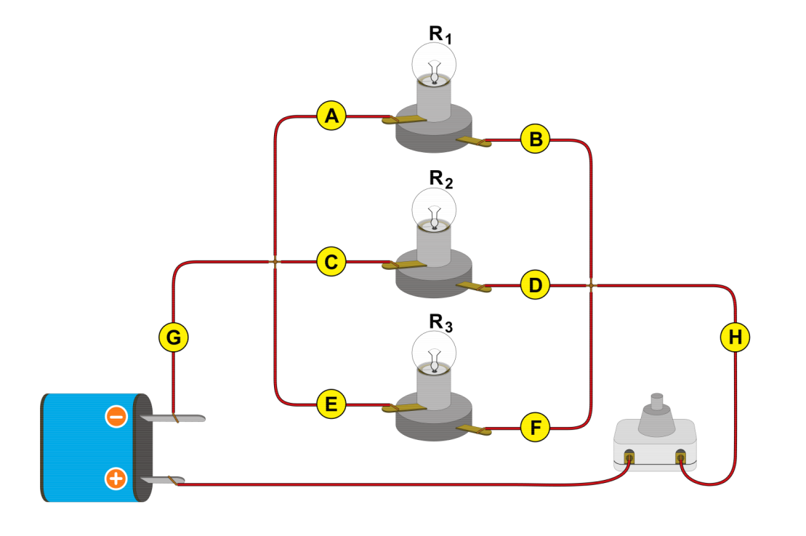
How does an electrical circuit work?
Exploring Ohm’s Law in parallel and series circuits
^{Experiment}
Repeat step 2 recording the voltage between points B and C (V₂), between points C and D (V₃), and between A and D (V_{T}). Once you have finished measuring voltage in the series circuit turn the switch off and turn the parallel circuit on.
Record voltage between A and B (V₁), C and D (V₂), E and F (V₃) and finally between G and H (V_{T}). Once you have finished, stop recording.
Parallel circuit

Slide 17
How does an electrical circuit work?
Exploring Ohm’s Law in parallel and series circuits
^{Experiment}
Re-configure the sensor following the Labdisc configuration steps. Select the current sensor in step 4. Turn the series circuit on and record electric current at I₁, I₂ and I₃. Once you have finished, turn the Labdisc off.
Turn the parallel circuit on and record current in I₁, I₂ and I₃. Once you have finished, turn the Labdisc off.
Finally, observe what happens if you disconnect each load in both circuits. For example disconnect R₁ and observe what happens. Repeat the observation with L₂ and L₃.

Slide 18



How does an electrical circuit work?
Exploring Ohm’s Law in parallel and series circuits
^{Results and analysis}
Connect the Labdisc to the computer using the USB communication cable or via the Bluetooth wireless communication channel.
On the upper menu press the button and select .
Observe the graph displayed on the screen.
Press the button and write notes on the graph specifying the variable that was being measured in each vertical bar. Label the bars that belong to the parallel circuit and the ones that belong to the series circuit.
Repeat the operation starting from step two, and select the last experiment.

Slide 19

How does an electrical circuit work?
Exploring Ohm’s Law in parallel and series circuits
^{Results and analysis}
How do the results relate to your initial hypothesis? Explain
Can you see the relationship between electric voltage and current represented on the graph?
What happened in the series and parallel circuits once you disconnected a load?

Slide 20
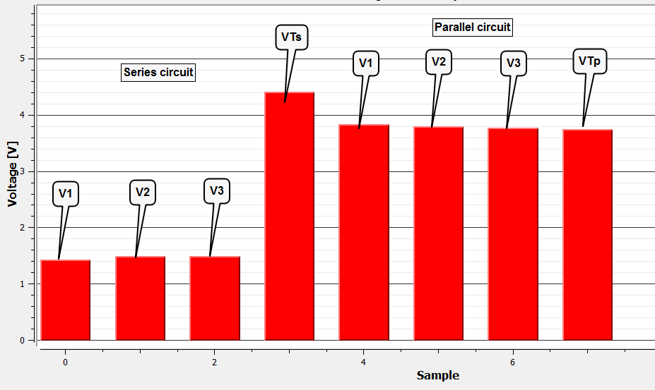
How does an electrical circuit work?
Exploring Ohm’s Law in parallel and series circuits
^{Results and analysis}
The graph below should be similar to the one the students came up with.

Slide 21
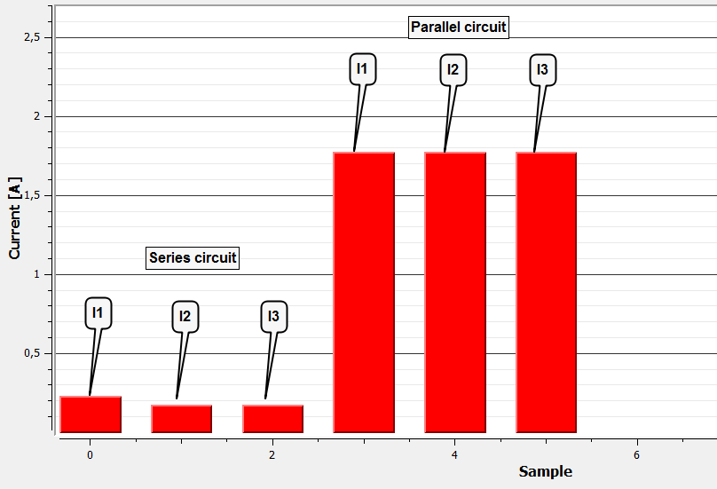
How does an electrical circuit work?
Exploring Ohm’s Law in parallel and series circuits
^{Results and analysis}
The graph below should be similar to the one the students came up with.

Slide 22


How does an electrical circuit work?
Exploring Ohm’s Law in parallel and series circuits
^{Conclusions}
In case you need it, use the following formula to calculate the percentage error:
Calculate the percentage error for the experimental value of the total voltage in the series and parallel circuit. Remember that the theoretical value is equal to the voltage value labeled on the battery.
Students should compare their experimental values to the theoretical values and calculate the percentage error. Next we present the problem’s solution:
Series electric circuit
Parallel electric circuit

Slide 23

How does an electrical circuit work?
Exploring Ohm’s Law in parallel and series circuits
^{Conclusions}
Use the information displayed on the chart and the one provided in the theoretical framework to calculate the total electric current in both circuits.
Students should use their results and the information presented in the theoretical background to calculate total electric current (I_{T}). To calculate total electric current in the series circuit we took the average of three points.
Series electric circuit
Parallel electric circuit

Slide 24




How does an electrical circuit work?
Exploring Ohm’s Law in parallel and series circuits
^{Conclusions}
If we consider that all resistance loads were similar in the circuits, we can obtain that the total current in the parallel circuit is 9 times higher than the electric current in the series circuit. Use Ohm´s Law to check if you obtained the same relationship using your results.
Before you answer, take a look on the following algebraic demonstration of the relationship between the electric current in the series circuit and the current in the parallel circuit.
R_{T} in series circuit (R_{TS}) and in parallel circuit (R_{TP})
Using R value obtained by solving equation (2), we obtained:

Slide 25




How does an electrical circuit work?
Exploring Ohm’s Law in parallel and series circuits
^{Conclusions}
Now we can calculate the total electric current using Ohm´s Law. First, we calculate the total electric current of the series circuit (I_{TS}) and then the total electric current of the parallel circuit (I_{TP}). Consider that the total voltage is equal to both circuits.
Insert (3) in (4)
Therefore the result of (6) is equal to the result of (5), therefore

Slide 26



How does an electrical circuit work?
Exploring Ohm’s Law in parallel and series circuits
^{Conclusions}
Students should now analyze their results and find out if these agree with the relationship presented earlier. Next we preset the solution to the problem:
In this case, the relationship was not the same as the theoretical value. Our results show that total current in the parallel circuit is 27.9 times the total current in the series circuit. However, it is important to notice that there is a greater amount of total current in the parallel circuit, if we compare it to the current in the series circuit.

Slide 27

How does an electrical circuit work?
Exploring Ohm’s Law in parallel and series circuits
^{Conclusions}
How would you explain the differences between the theoretical values and the experimental values?
Students should think of possible answers to this question. For example, one circuit may have used more cable length than the other. The copper wire itself also presents a resistance that adds its value to the total resistance. On the other hand, we can also consider experimental errors that may happen, for example the electrodes may have been placed incorrectly. These errors would change the results of the experiment.
During the last step of the experiment you disconnected the loads. On which circuit were the loads independent of each other?
Students should point out that in the parallel system the loads are independent of each other. Because of this property, you can observe that if you disconnect one light bulb (load) the rest of the light bulbs will still shine.

Slide 28
How does an electrical circuit work?
Exploring Ohm’s Law in parallel and series circuits
^{Conclusions}
Students should reach the following conclusions:
Parallel and series circuits have different properties. A lot of them can be explained by using Ohm´s Law. For example, if you have two kinds of circuits (one parallel circuit and one series circuit) with the same amount of similar loads, and the same power supply, resistance will be 9 times more in a series circuit and an electric current will be 9 times more than the current in the parallel system.
On the other hand, if you disconnect one load in a parallel system, the other loads will keep working. This is because the current can still find a closed circuit to flow through. On the other hand, in a series circuit the loads are connected to a single connector, and therefore if we disconnect one load the circuit will break.

Slide 29

How does an electrical circuit work?
Exploring Ohm’s Law in parallel and series circuits
Activities for further application
Which kind of circuit do you use in your house?
Students should point out that they are able to disconnect one device without affecting the others, i.e. if one light bulb burns out, the rest can still be used. Therefore we can conclude that we use a parallel circuit in our house.
Loads are devices that use electric current, transforming electrical energy into another kind of energy. Name at least one device that you know to transform electrical energy into light, sound waves, thermal energy and mechanical energy.
Students should identify several types of loads. Some examples could be: A light bulb transforming electric energy into light; an electric bell transforming electricity into acoustic energy (sound waves), a heater transforming electric energy in thermal energy (heat), and a fan transforming electric energy into mechanical energy.

Slide 30
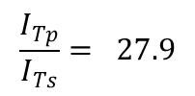


How does an electrical circuit work?
Exploring Ohm’s Law in parallel and series circuits
Activities for further application
Use Ohm´s Law to solve the following problem: “A 5.1 battery supplies power to a circuit with a current of 0.1 A flowing through it. What is the resistance of the load in the circuit?”
Ohm´s Law states:
Therefore:

Slide 31


